Slide 1
CS F372 Operating Systems
18 – Memory management – Virtual memory

Slide 2
Text Book Reading
Chapter 9
Sections 9.1, 9.2

Slide 3
Virtual memory
Virtual memory is a technique that allows
execution of processes that are not completely in main memory
programs can be larger than physical memory
Instructions that are currently being executed must be placed in physical memory
Place the entire program in physical memory
Limits the size of the program to the size of the physical memory

Slide 4
Virtual memory
Virtual memory - motivation
Code for handling error conditions
Unused space occupied by arrays, lists, tables etc.
Code for rarely used features
Even when entire program is used, all portions of the program may not be used at the same time
Virtual memory - advantages
Programs not constrained by the physical memory available
Increased CPU utilization
Less I/O is needed

Slide 5
Virtual Memory
Separation of user logical memory from physical memory
Only part of a program needs to be in physical memory for execution
Logical address space can therefore be much larger than physical address space
Allows a large virtual memory to be available for programmers when only small physical memory is available

Slide 6
Demand Paging
Virtual memory can be implemented by Demand paging
Load pages in primary memory only when they are needed (demanded) during execution
Pages that are never accessed are thus never loaded into physical memory
Paging system with swapping
Process reside in secondary memory
When needed to be executed, process is swapped into main memory
Instead of bringing in the whole process, only the pages which are currently needed are brought in

Slide 7
Demand Paging
Avoids bringing in pages which will not be used at all
Less I/O needed
Less physical memory needed
More users (Degree of multi programming is increased)
High CPU utilization and throughput

Slide 8
Demand Paging
Need to differentiate between the pages in main memory and those on disk
Valid (v) / invalid (i) bit is used
Bit is set as valid
Page is present in main memory
Bit is set as invalid
Page is not present in the main memory

Slide 9
Demand Paging
Need to differentiate between the pages in main memory and those on disk
Valid (v) / invalid (i) bit is used
Bit is set as valid
Page is in the logical address space of the process and present in main memory
Bit is set as invalid
Page is not valid (not in the logical address space of the process) or
Page is valid but not present in the main memory

Slide 10
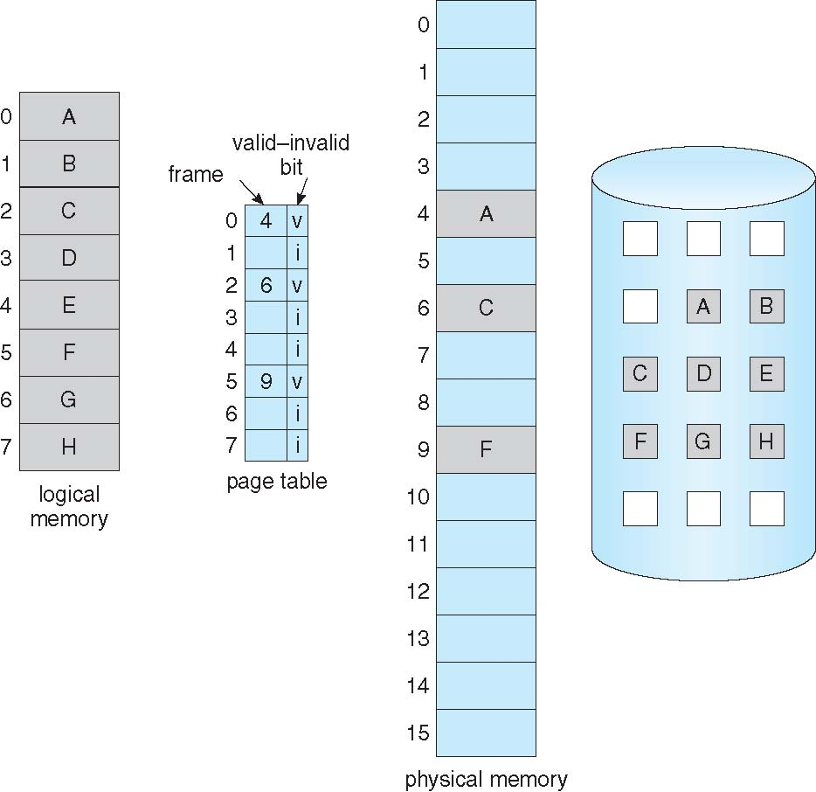
Page Table When Some Pages Are Not in Main Memory

Slide 11
Page Fault
When the process accesses the pages that are in memory, execution proceeds as normal
When the process accesses a page that is not in memory
Page fault
Access to a page marked invalid causes a page fault
Cause a trap (interrupt) to the operating system

Slide 12
Servicing a page fault
Trap is generated and control is transferred to the OS
Save the user registers and process state
OS determine that the interrupt was a page fault
OS looks at another internal table kept in PCB to decide
Invalid reference => abort
Just not in memory
Get empty frame from free-frame list
Swap page into frame
Issue a read from the disk to a free frame
Wait in a queue for the disk until read request is serviced
Begin the transfer of page to a free frame

Slide 13
Servicing a page fault
While waiting, allocate the CPU to some other user
Receive an interrupt from the disk (I/O completed)
Save registers and process state for currently executing process
Determine that the interrupt was from the disk
Correct the page table and other tables to show that the desired page is now in memory
Wait for the CPU to be allocated to this process again
Restore the user registers, process state, new page table
Restart the interrupted instruction

Slide 14
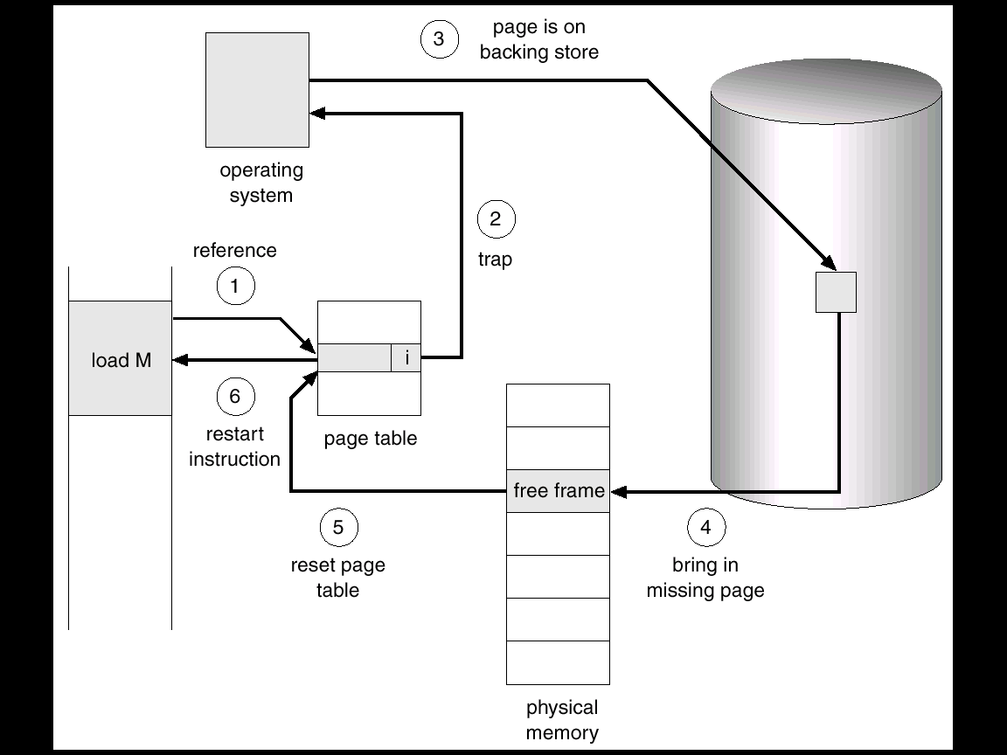
Steps in Handling a Page Fault

Slide 15
Performance of Demand Paging
Demand paging can significantly affect the performance of a computer system
effective access time
When there is no page fault
effective access time is same as the memory access time (10 -200 nsec)
If page fault occurs
Read the relevant page from disk
Then access memory to access the desired word

Slide 16
Performance of Demand Paging
p - Probability of a page fault
0 ≤ p ≤ 1.0
if p = 0, no page faults
if p = 1, every reference is a fault
Effective Access Time (EAT)
= (1 – p) x memory access time + p x page fault service time

Slide 17
Effective Access Time
Page fault service time – 8 ms
Memory-access time – 200 ns
Effective memory access time = (1-p) x 200 + 8,000,000 x p
Effective memory access time = 200 + 7,999,800 x p
Effective access time is directly proportional to page fault rate
Suppose if one access out of 1,000 causes a page fault, p = 0.001
Effective memory access time = 8,200 = 8.2 microseconds
The computer will be slowed down by a factor of 40 because of demand paging!
It is important to keep the page-fault rate low otherwise, the effective access time increases, slowing process execution

Slide 18
Buddy System of memory allocation
Allocates memory contiguously
Memory is allocated in powers of 2
If the incoming request is not an exact power of 2 it is rounded off to the next highest nearest power of 2
Example request size is 11 KB = 16 KB
From the available memory, a suitable sized block is then allocated to the requesting process
Entire space available is treated as a single block of 2^{U}
If a request of size s such that 2^{U-1} < s <= 2^{U}, entire block is allocated
Otherwise block is split into two equal buddies
Process continues until smallest block greater than or equal to s is generated

Slide 19
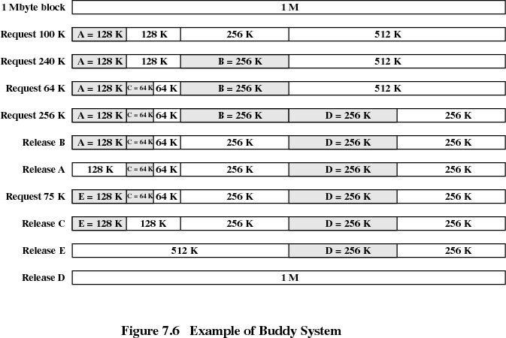

Slide 20
